Slide 1
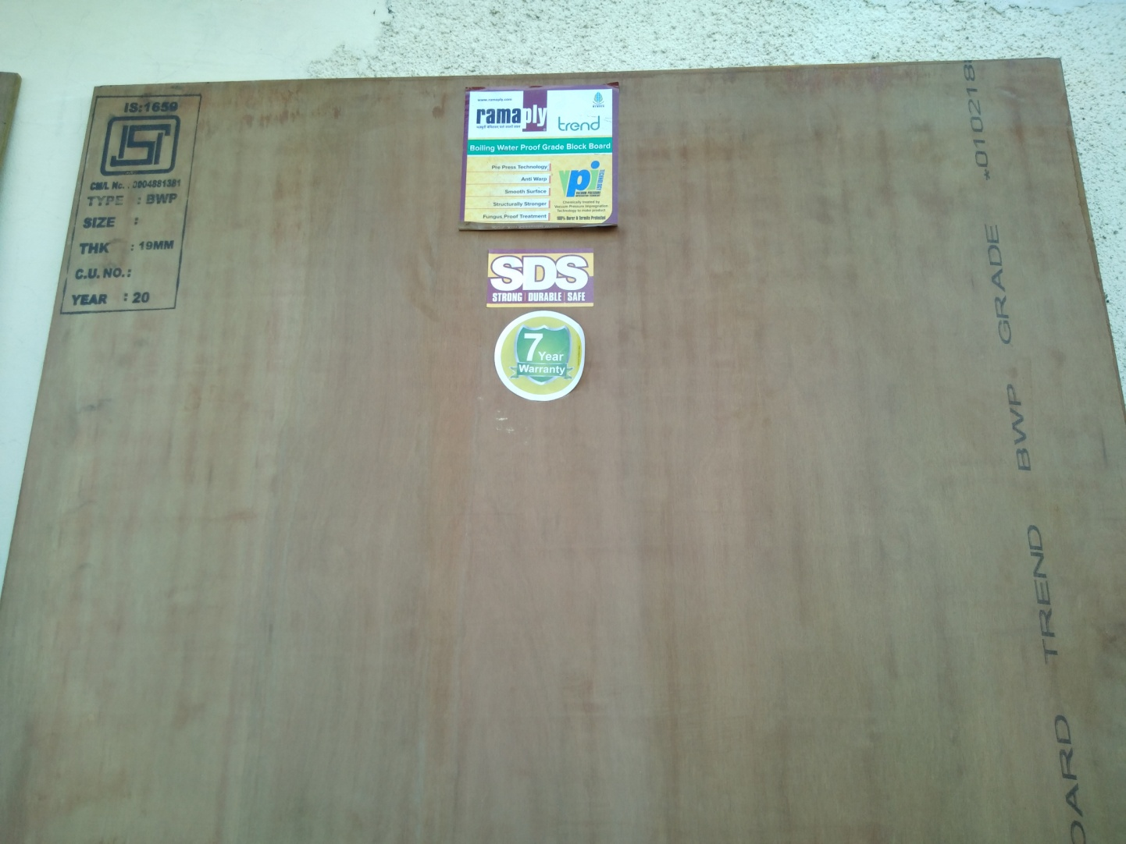
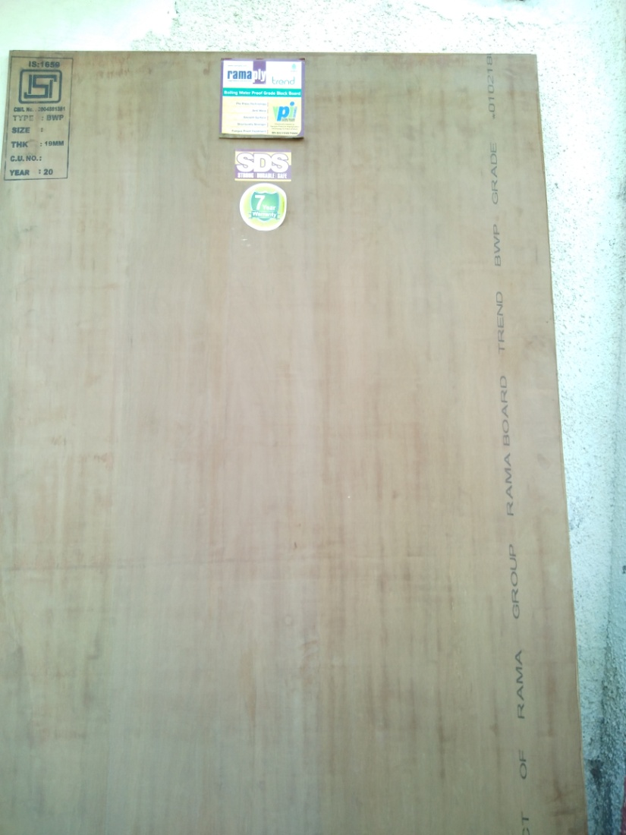
BWP Trend BB
Notes:
SUGGESTION OF ROLLER ON SINGLE /BOTH SIDE

Slide 2
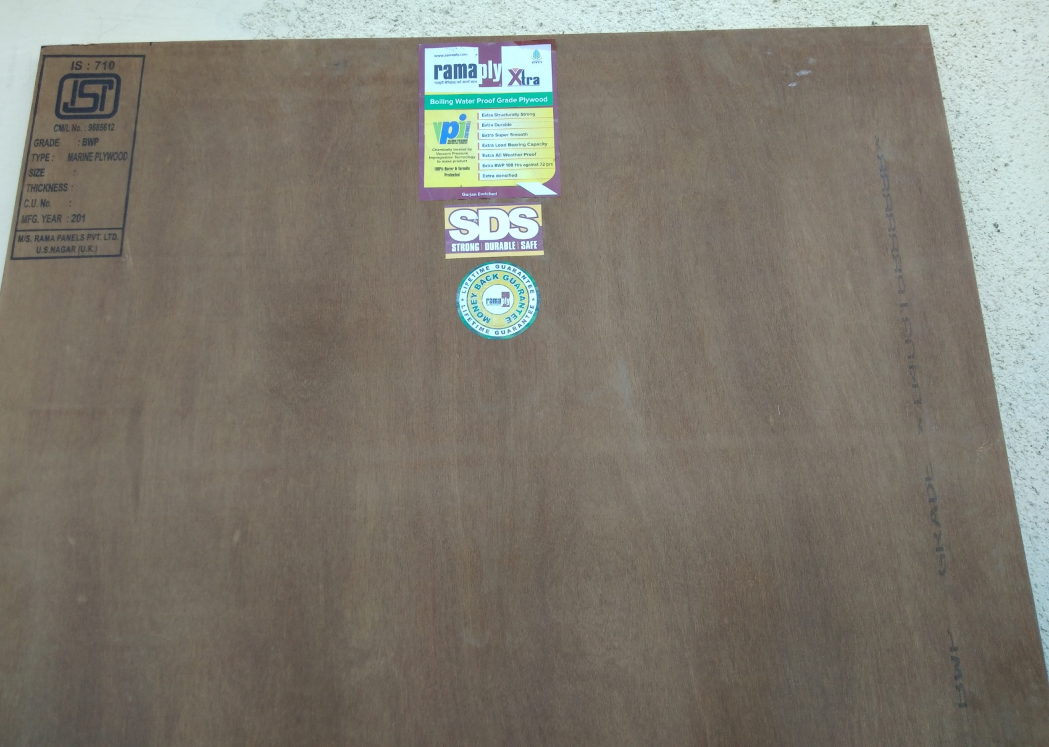
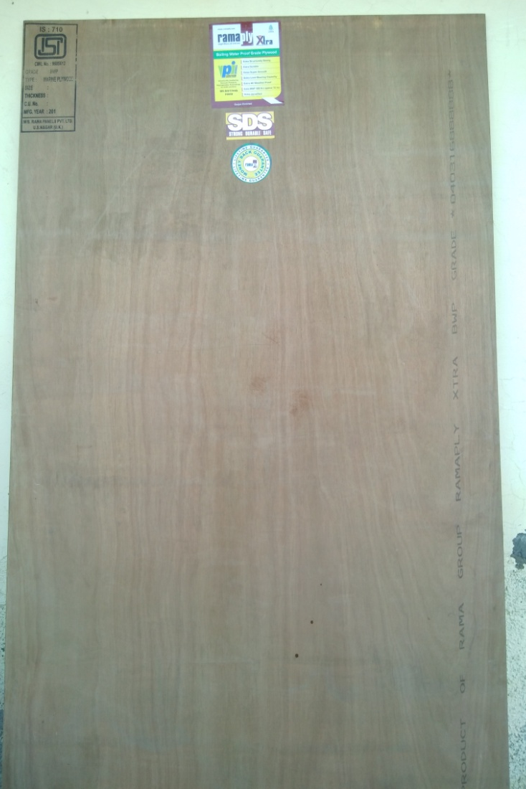
BWP Extra Ply

Slide 3
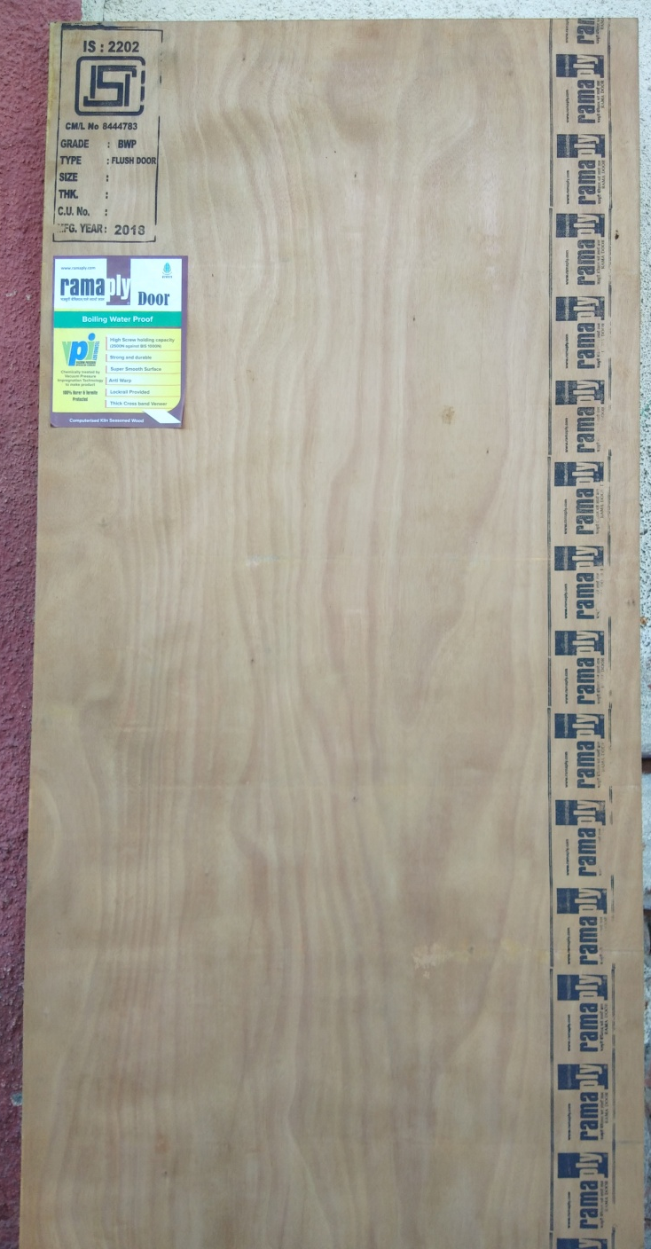
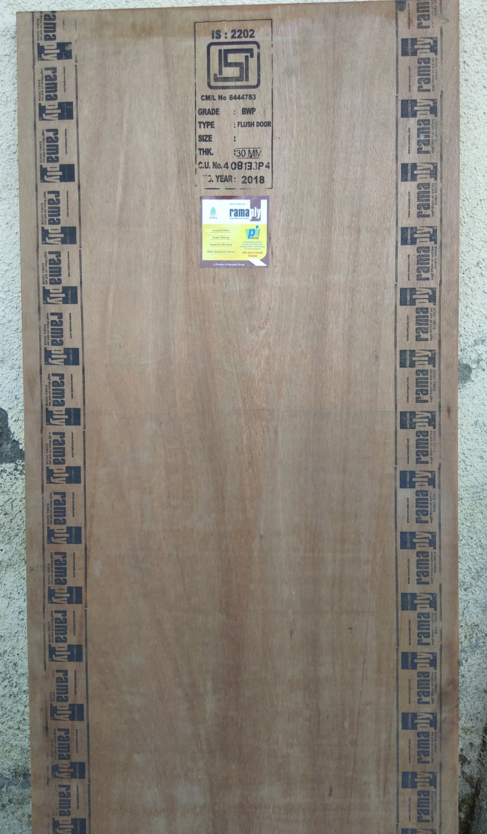
Door
New proof
Notes:
Changes in Door Rollar
Rollar same as Ultis but rollar width will be 75MM

Slide 4
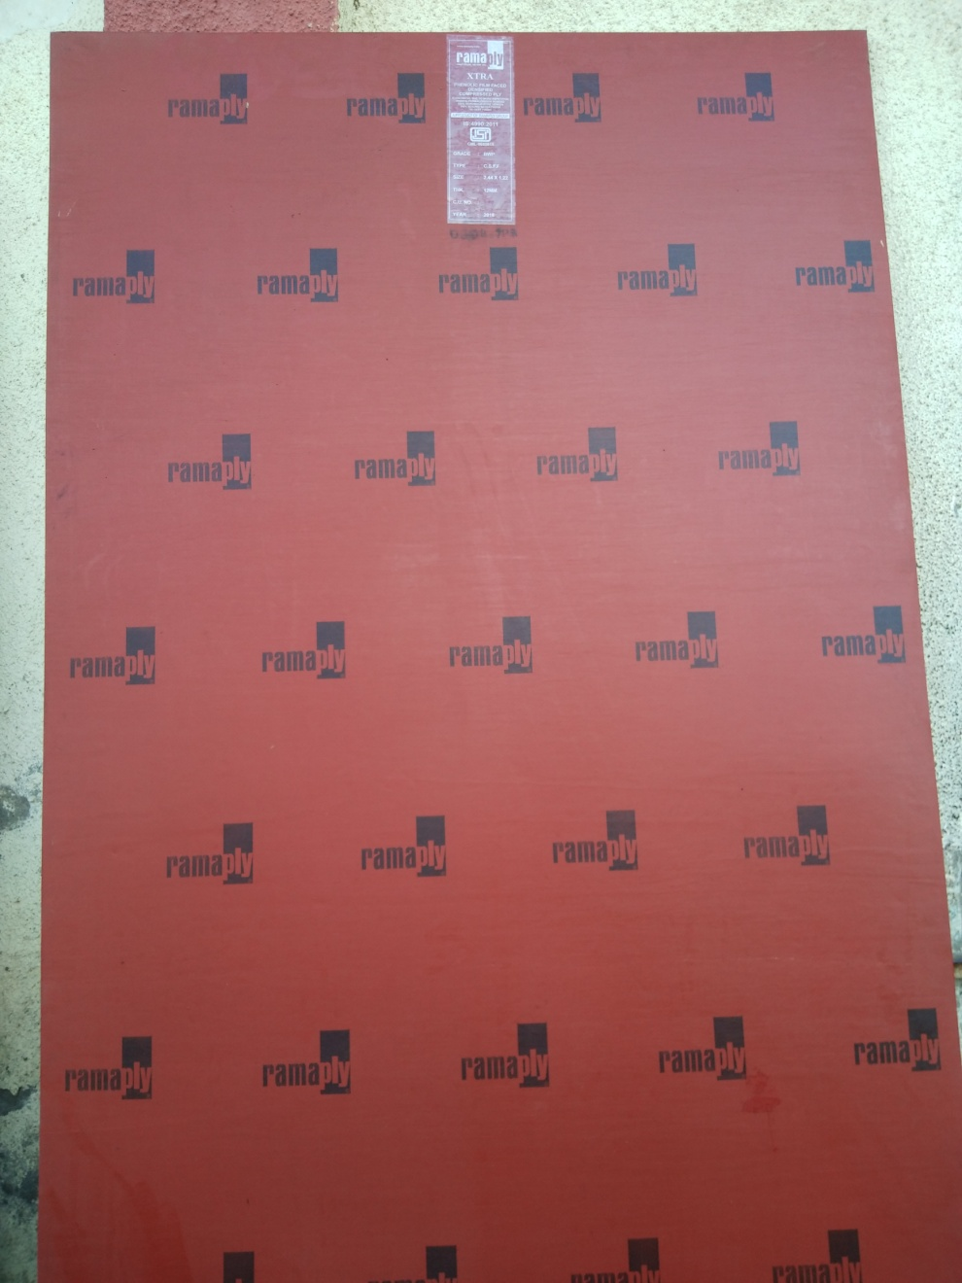
Film Face FOR Project supply
1- 21 Kg – Trend - PVC Sticker
2- 23Kg- Trend Plus - PVC Sticker
3- 30Kg- Xtra - PVC Sticker
4- 34Kg – Xtra Plus – PVC Sticker
Notes:
PVC to sticker

Slide 5
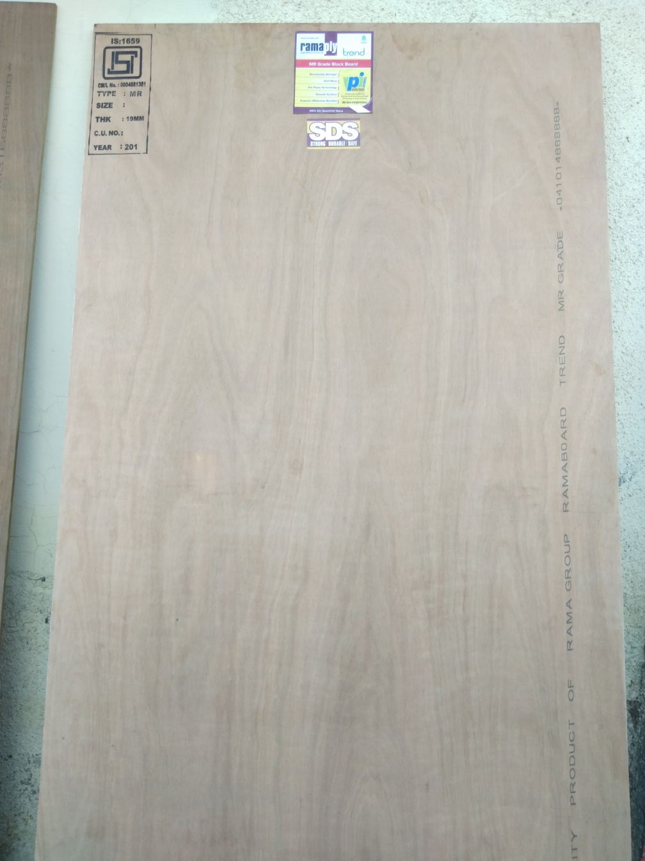
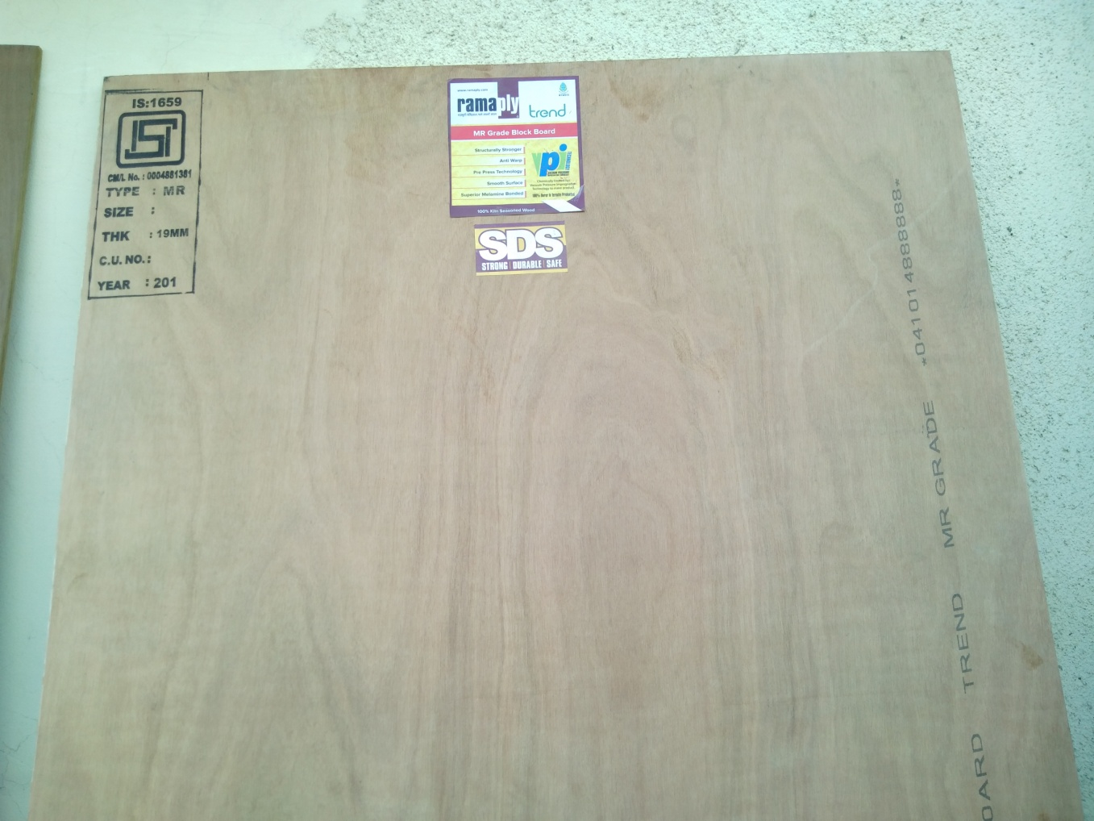
MR Trend BB

Slide 6
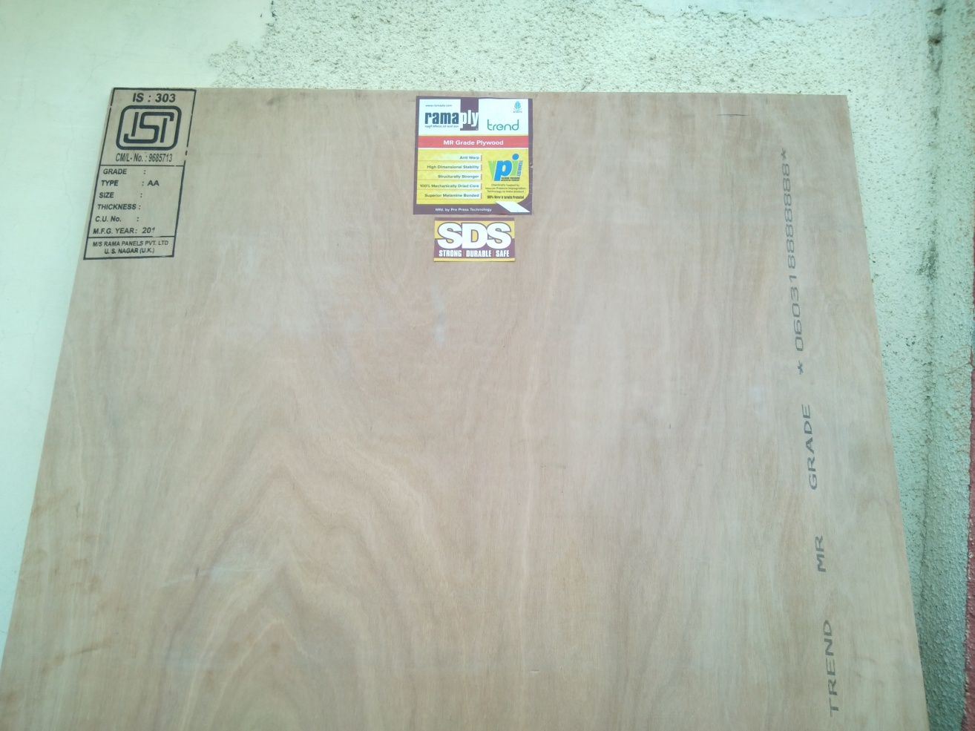
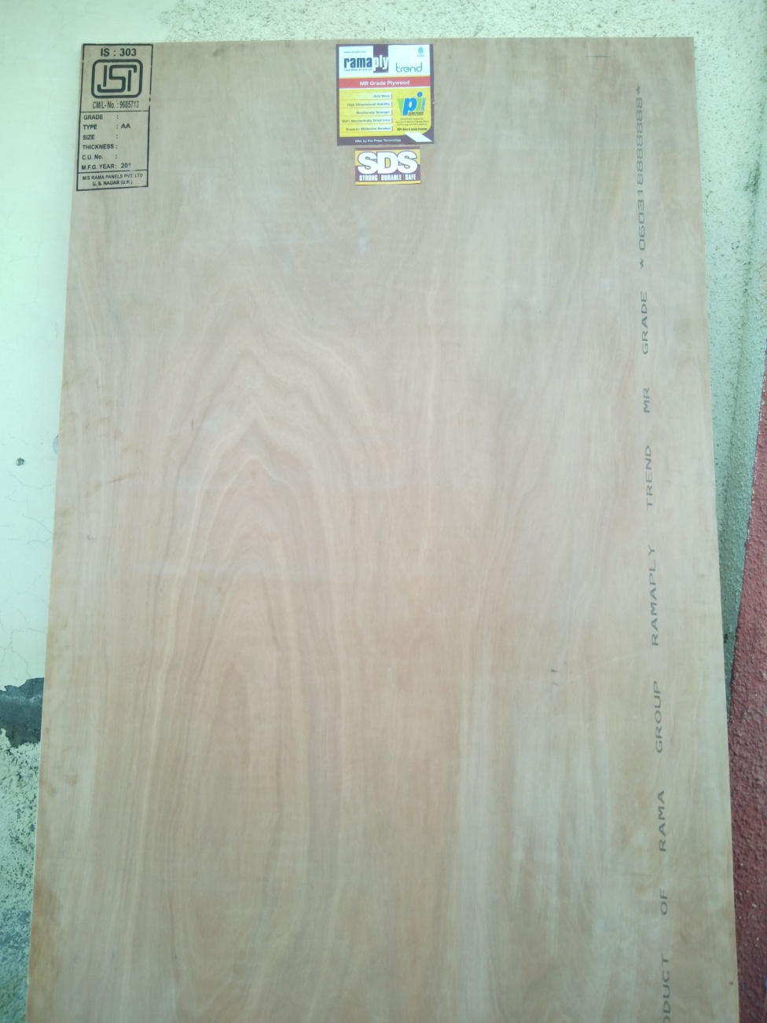
MR Trend Plywood

Slide 7
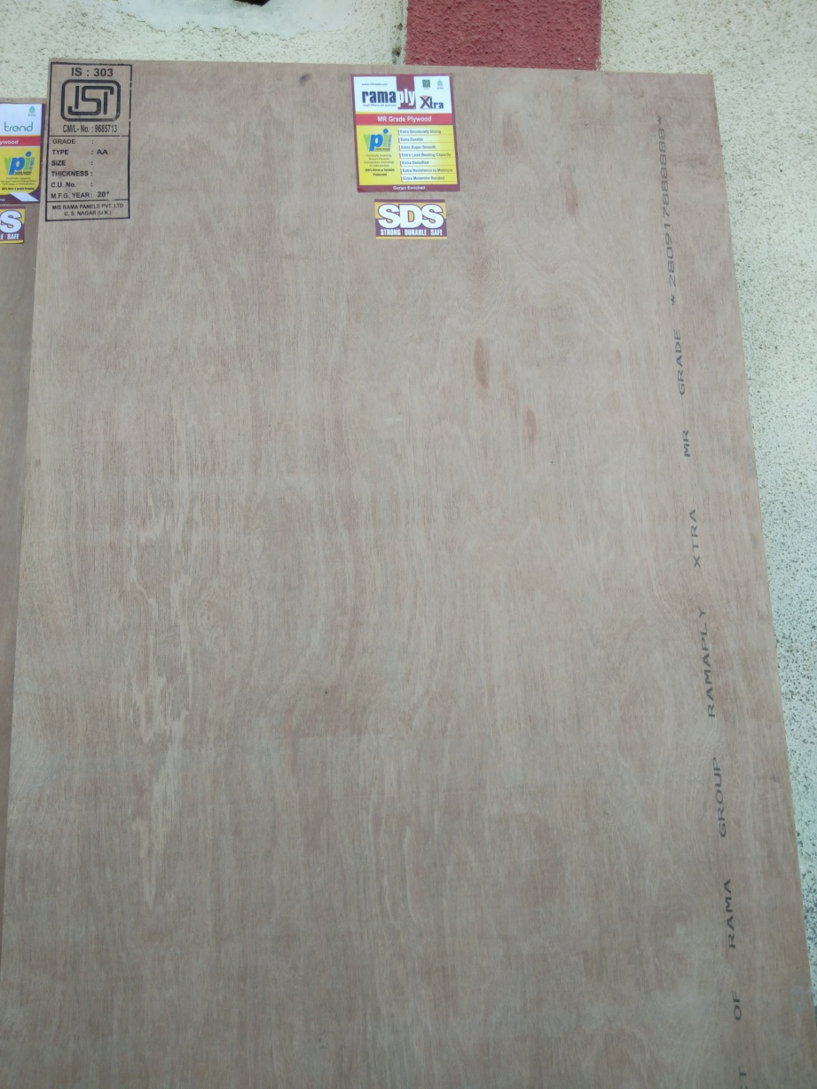
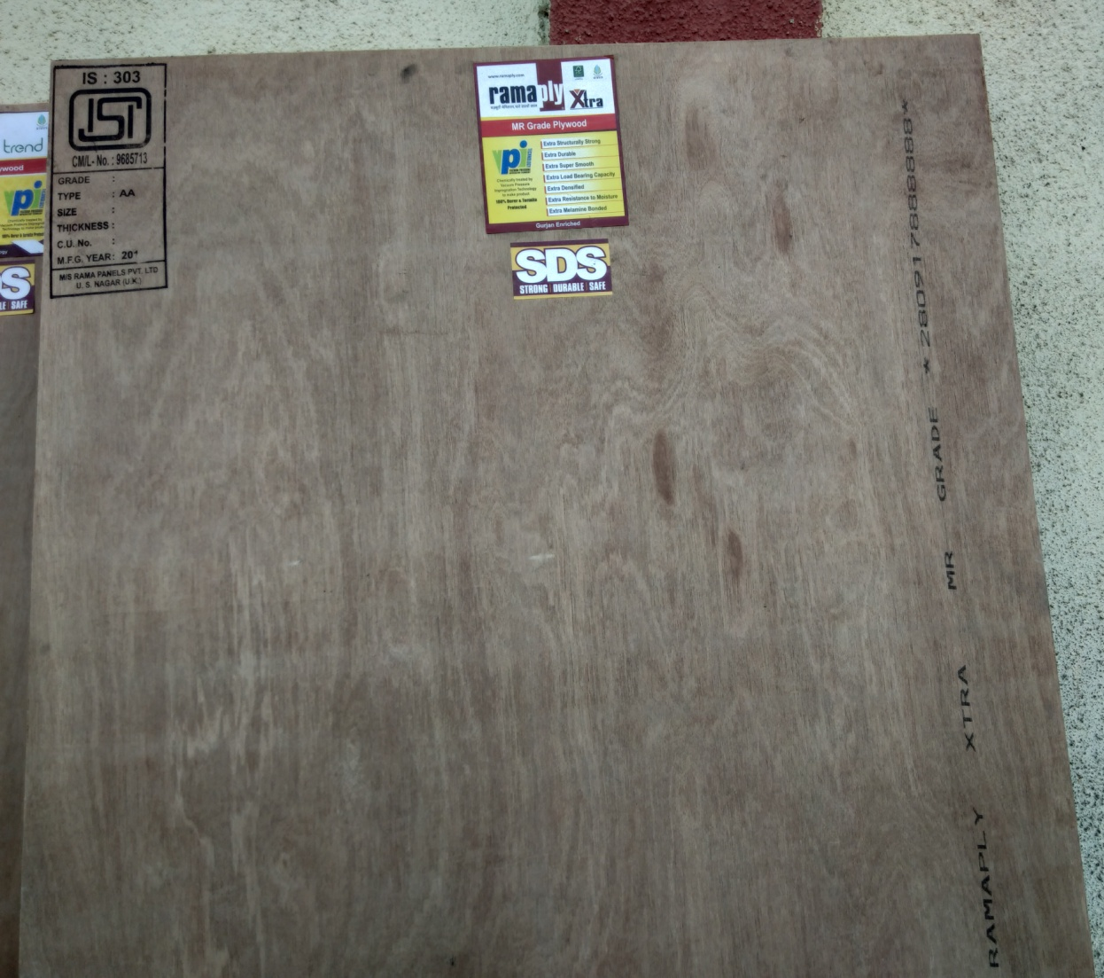
MR Extra Ply

Slide 8
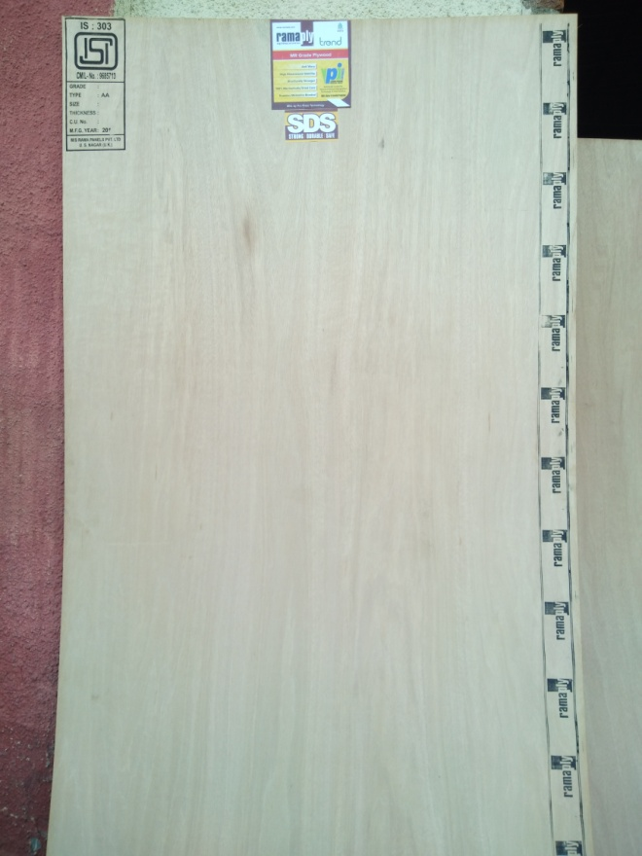
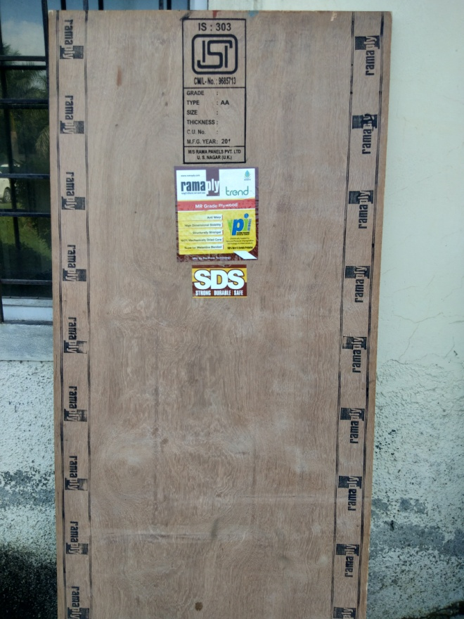
P
P1

Slide 9
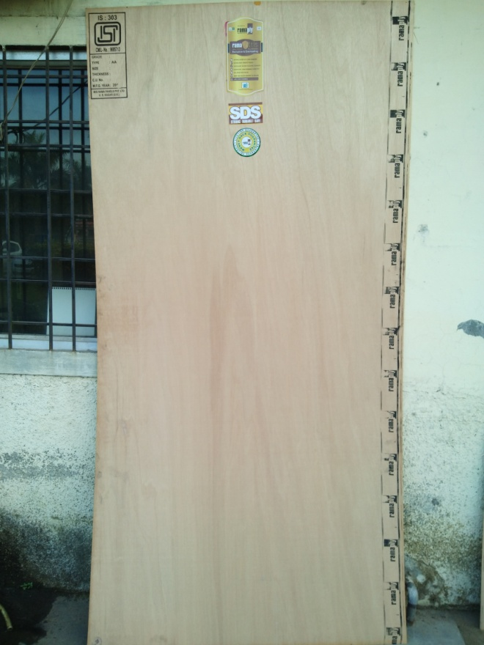
P
P3 ULTIS
P4 ULTIS

Slide 10
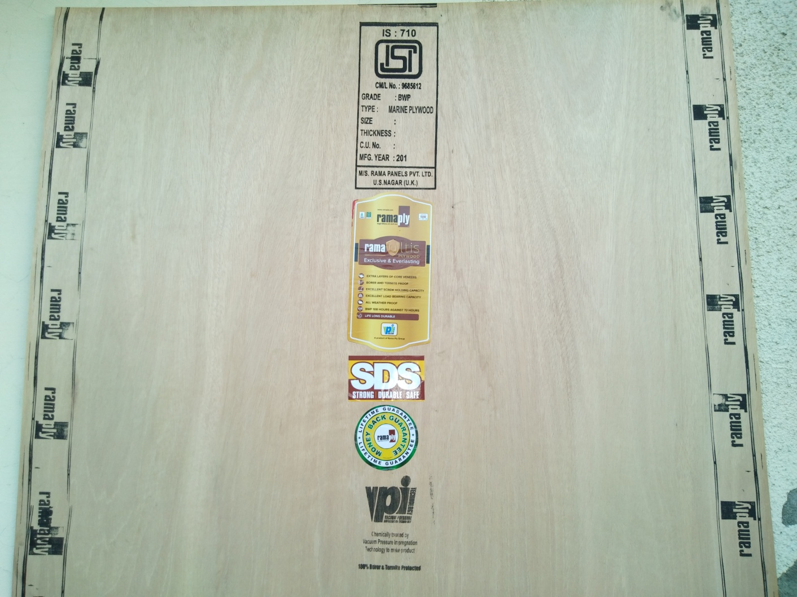
P 5 Ultis
Notes:
Colour of roller ink
Size of sticker
SDS stikcer
Warranty Sticker
VPI Sticker

Slide 11


Slide 12
